Slide 1
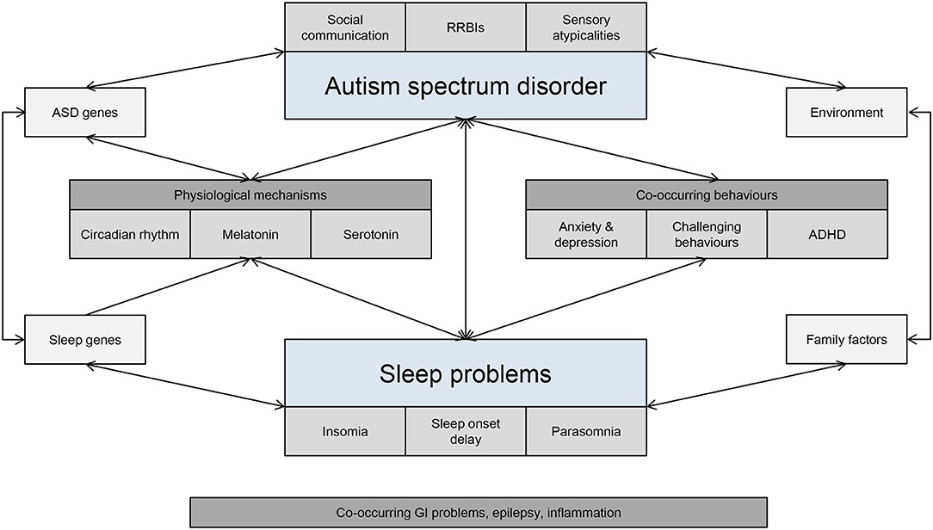
SEND and Sleep
Don’t give up – You need to follow through on your commitment to their sleep even when it gets hard, so who do you have to support you to support them? Think about what happens at weekends and school holidays, are you still being consistent?
Move and Munch – Get moving in the afternoons, give their bodies a reason to need sleep, then watch those sugars after lunch, their bodies may not have burnt through the additional energy rush
Be Prepared – You all know about bedtime routines and the nourishment this provides is vital to good sleep, so calm the environment and help their brains and senses de-stimulate from the day
Ask for Help – Family, Friends, School Nurse, GP – If after 3 weeks you can proudly say you have stuck to your changes then get some help for your child and yourself
Kindness and Resilience – No child (or parent!) wants to be lacking in sleep, there is something that isn't quite working right yet, so work together, help your child to be a part of the solution ♥♥
Prioritize Sleep – Set aside 3 weeks to make a change and stick with it. Pushing back sleep by 1 hour has shown to increase the quality for the shorter amount of time as tiredness levels are higher, it may seem counterintuitive but try it
Jo's Top tips:
Ball of Wool
Draft Excluder Dogs
Being Honest
ADD and Sleep Apnea: How Sleep Issues Can Look Like ADHD (additudemag.com)
Sleep Anxiety in Children - Good Bye Anxiety, Hello Joy (goodbyeanxietyhellojoy.com)
Parents and families (autism.org.uk)
Children on the autism spectrum and with ADHD can struggle to fall and stay asleep, they often sleep LESS than their neurotypical peers due to impairments of the body’s circadian rhythms, abnormalities in melatonin levels, an inability to understand social cues, feelings of anxiety, and sensory processing issues.
kindness

Slide 2
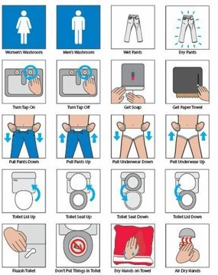
SEND and Toileting
Don’t give up – You need to follow through on your commitment to their toileting needs even when it gets hard, so who do you have to support you to support them? Think about what happens at weekends and school holidays, are you still being consistent?
Practise ALOT – Drink and toilet as much as you can, a minimum of 7 times a day. Support with any anxiety and use school holidays as a safe time to practice increases in liquids.
Be Prepared – You all know water and a healthy diet is the baseline for our health so calm the environment around them as what goes in, must come out!
Ask for Help – Family, Friends, School Nurse, GP – If after 3 weeks you can proudly say you have stuck to your changes then get some help for your child and yourself.
Kindness and Resilience – No child (or parent) wants to be incontinent, there is something that isn't quite working right yet, so talk together and help your child to be a part of the solution ♥♥
Prioritize Drinking – A 9-year-old should have 1800ml of non-food based liquids a day...try measuring it all out! What are they drinking? When are they drinking? When are they toileting?
Jo's Top tips:
Jelly Base Glasses
Stop the Plop
2 Hour Timers
Being Honest
Children With ASD/ ADHD are 3 x more likely to struggle. They often struggle into their teenage years commonly associated with a delay in development of the central nervous system. Children can struggle with voiding dysfunction (the difference between the involuntary bladder control and the over or under control of the sphincter. Our SEND children can have higher levels
Poo & Wee | Home | ERIC
Daytime Wetting | KidsHealth NZ
Toileting - a guide for parents and carers (autism.org.uk)
kindness

