Slide 1
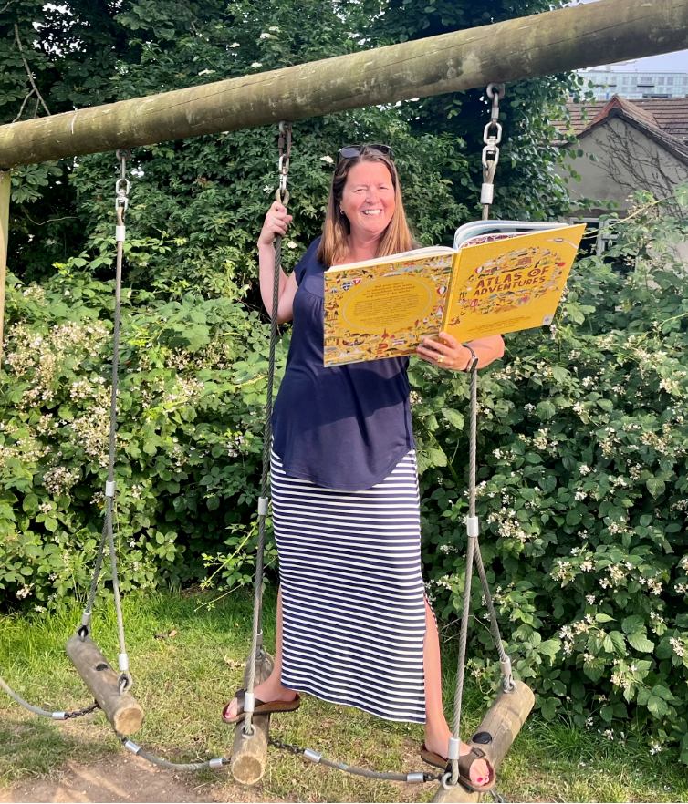
Extreme Reader
Atlas of Adventures
by Lucy Letherland
The book name and author go here.
Your photo goes here
I love reading adventure stories. They encourage me to become more adventurous and to take more risks.
The book I am reading here tells me all about places I could travel to on my adventures, I’m not sure I’m brave enough to canoe down the Zambezi River though!
This is a space to tell us a bit about the book or what you like to read.
Mrs Masters
Your first name and initial goes here.

Slide 2
Extreme Reader
Book Title
Name

