Slide 1
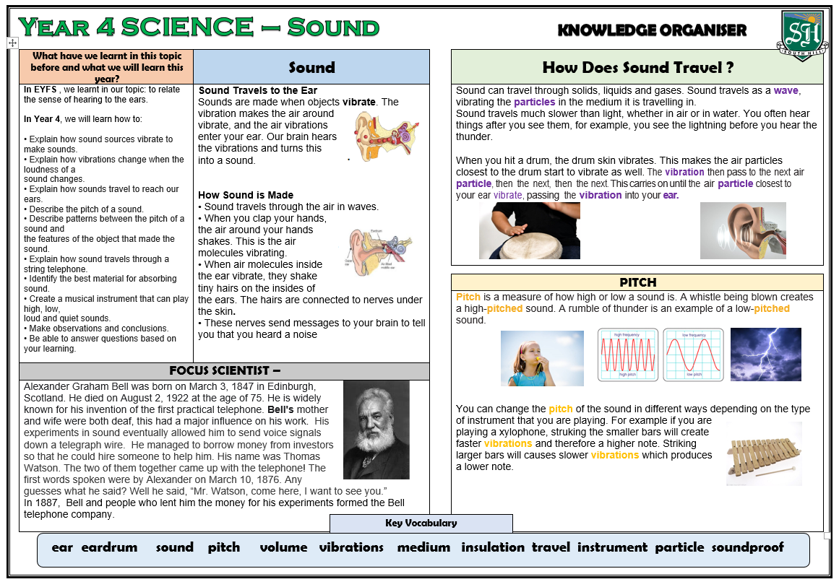
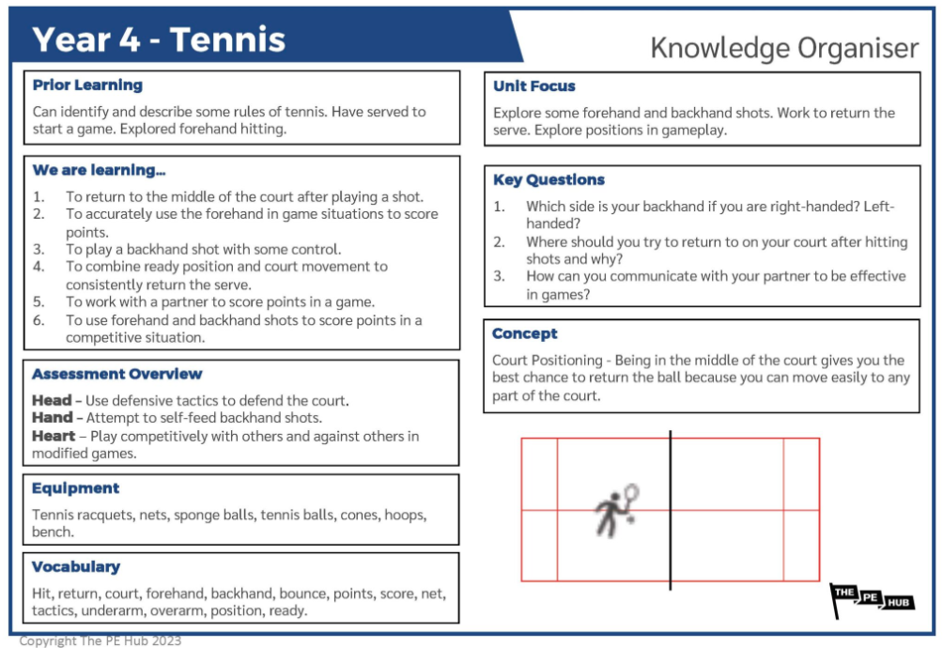
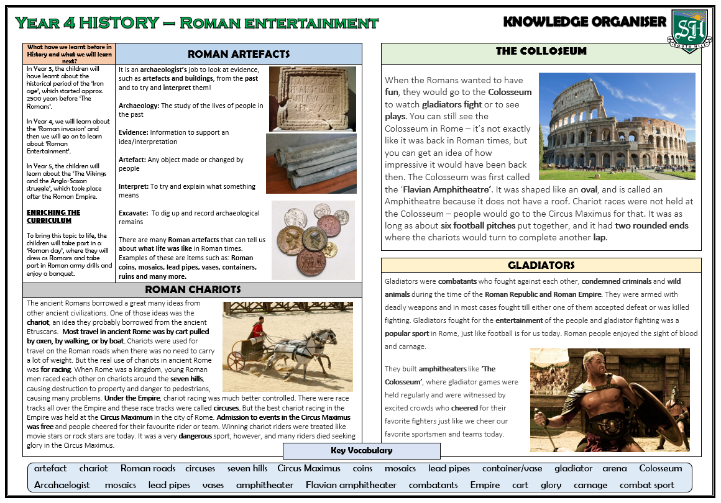
Year 2
Knowledge Organisers
At South Hill, we have created ‘Knowledge Organisers’ to help pupils and parents to know what the children will be learning in each of our Foundation subjects. These contain essential vocabulary and facts for each topic.
Please see ‘Knowledge Organisers’ attached for Year 2 for the autumn term, which will also be in pupil’s books and on working walls in school.

Slide 2
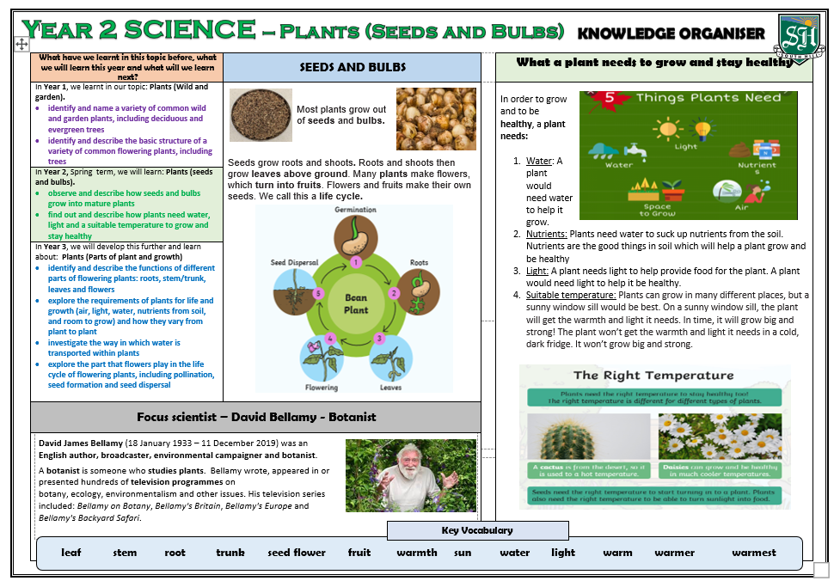
Year 2 Science – Summer 1

Slide 3
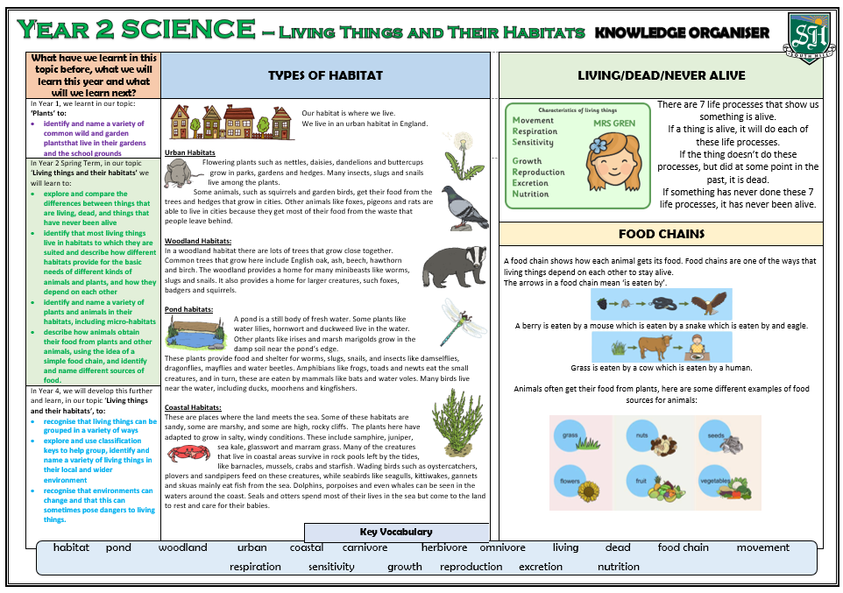
Year 2 Science – Summer 2

Slide 4
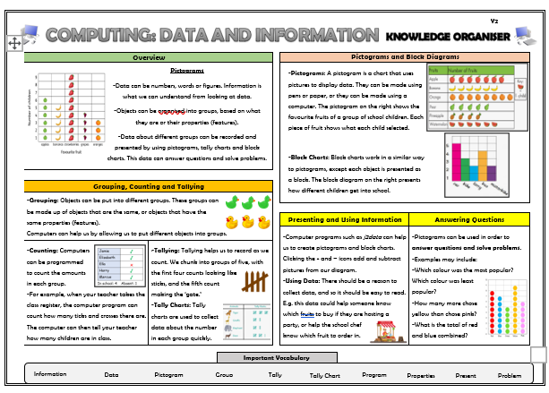
Year 2 Computing – Summer 1

Slide 5
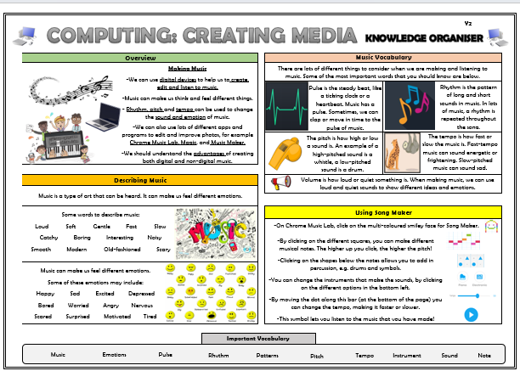
Year 2 Computing – Summer 2

Slide 6
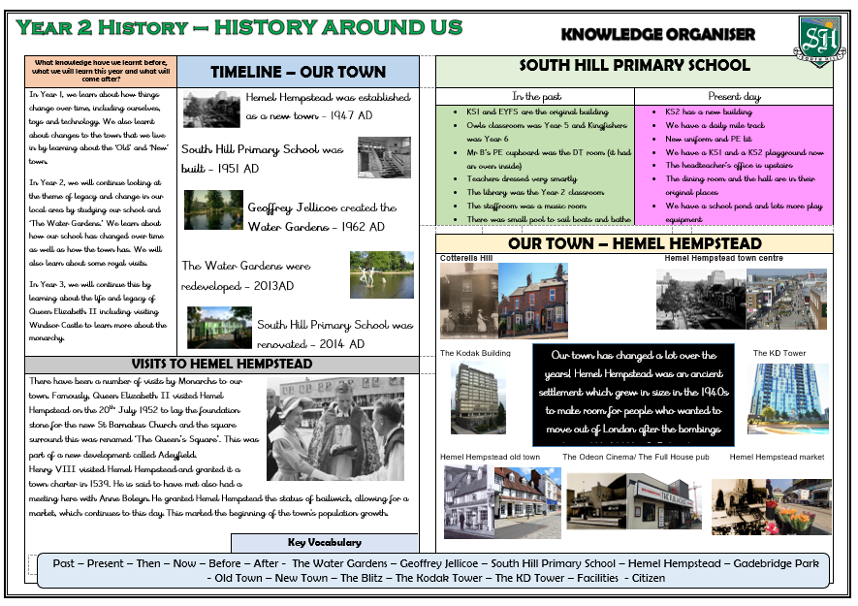
Year 2 History – Summer 1

Slide 7
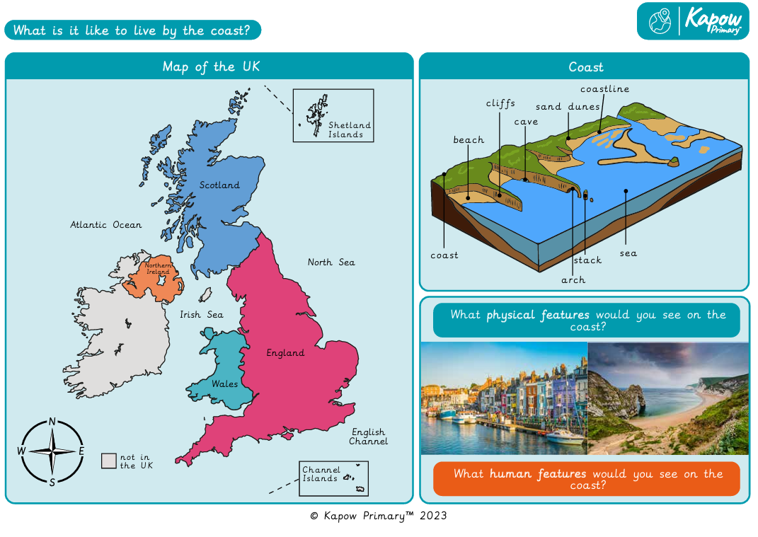
Year 2 Geography – Summer 2

Slide 8
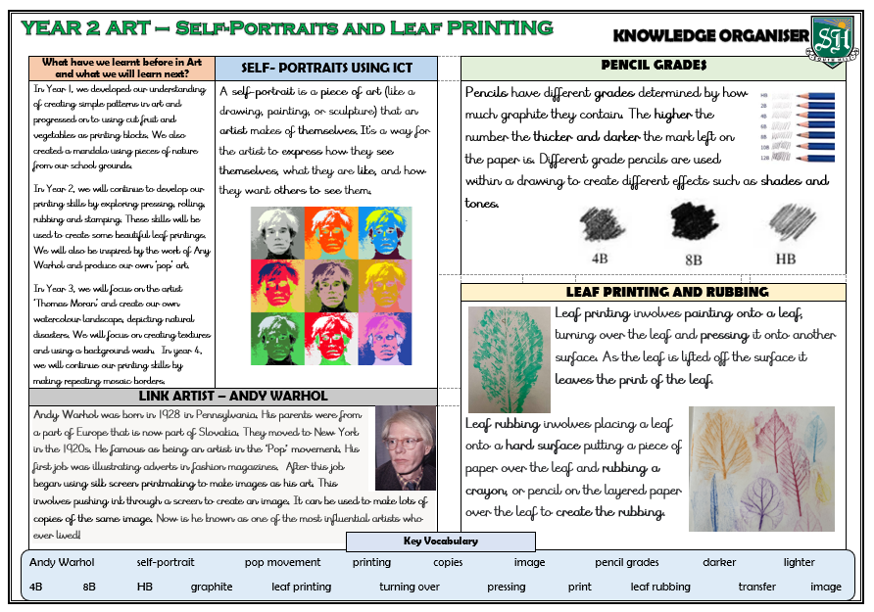
Year 2 Art – Summer 1

Slide 9
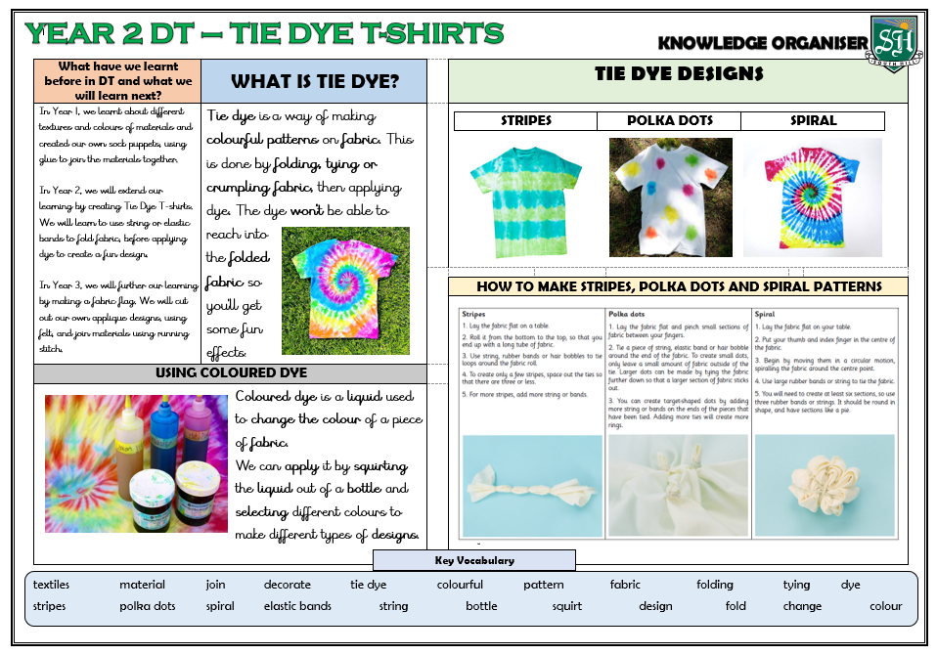
Year 2 DT – Summer 2

Slide 10
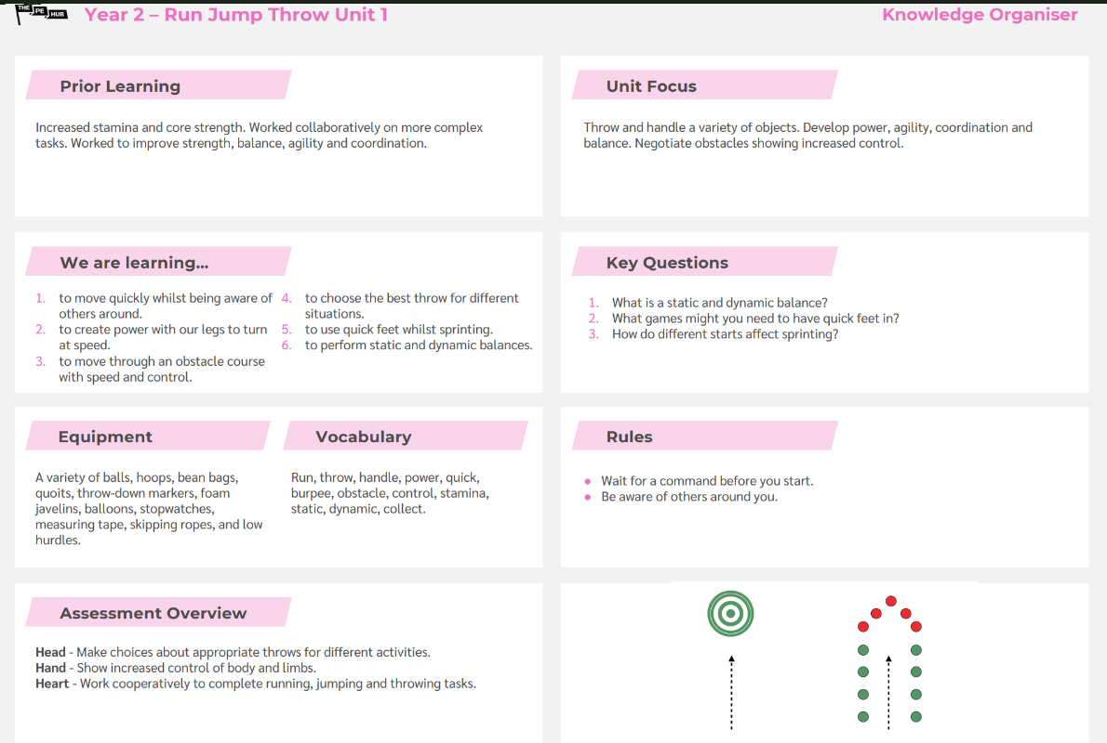
Year 2 PE – Summer 1

Slide 11
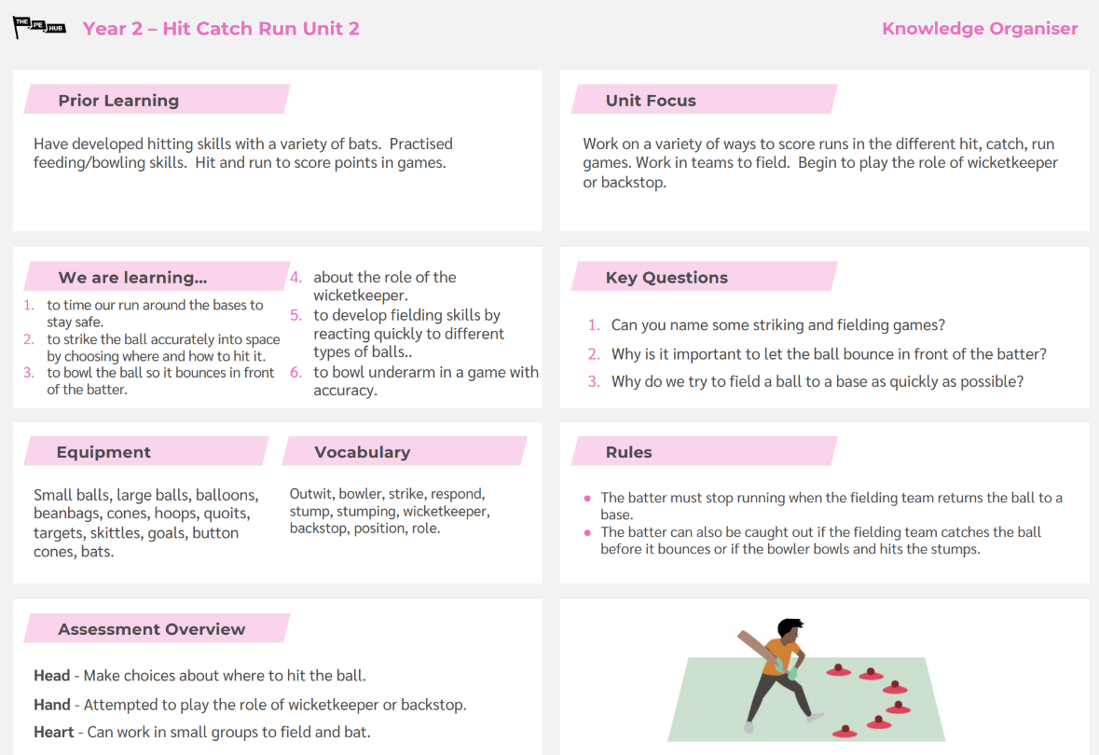
Year 2 PE – Summer 1

Slide 12
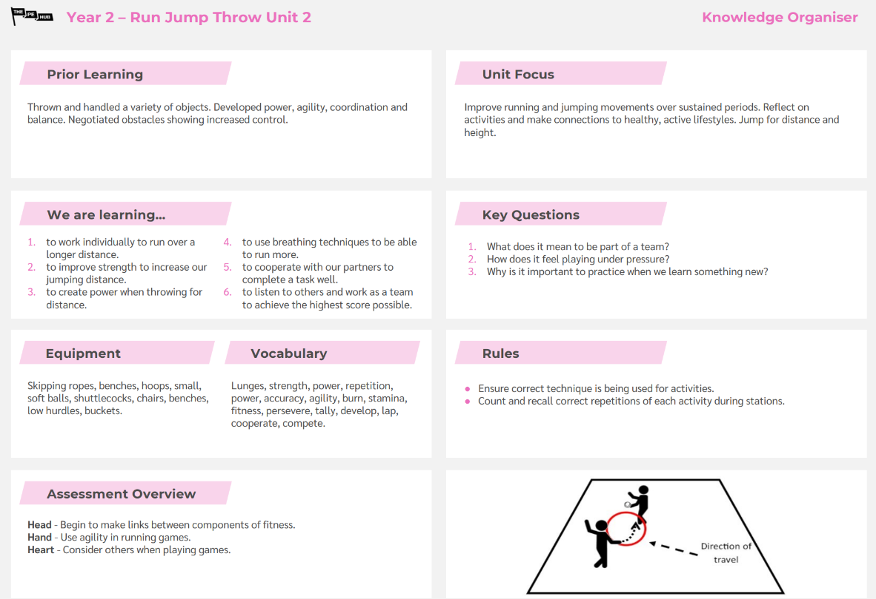
Year 2 PE – Summer 2

Slide 13
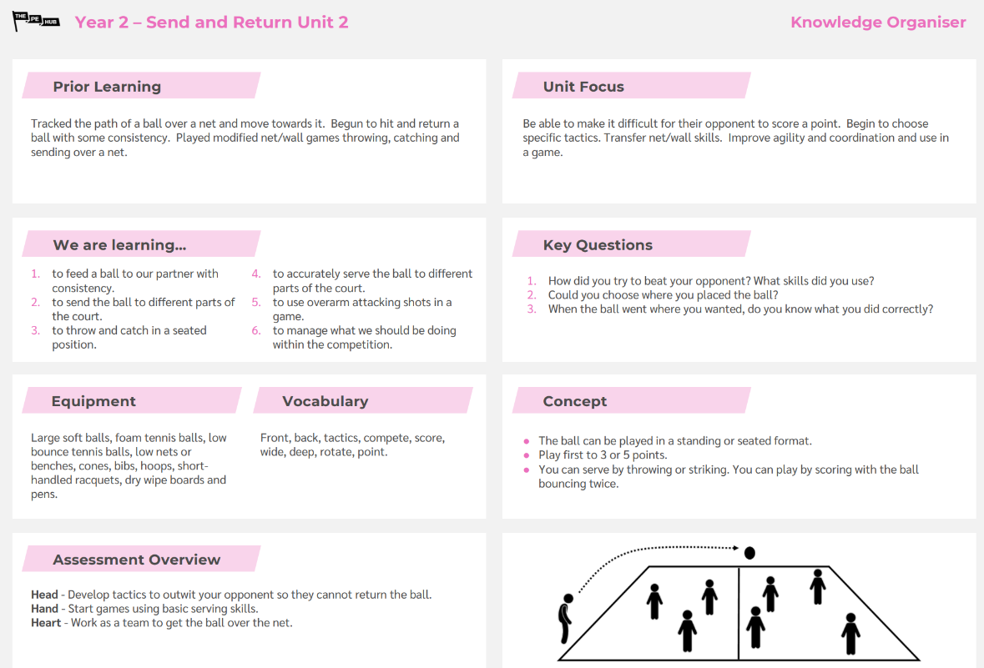
Year 2 PE – Summer 2

Slide 14
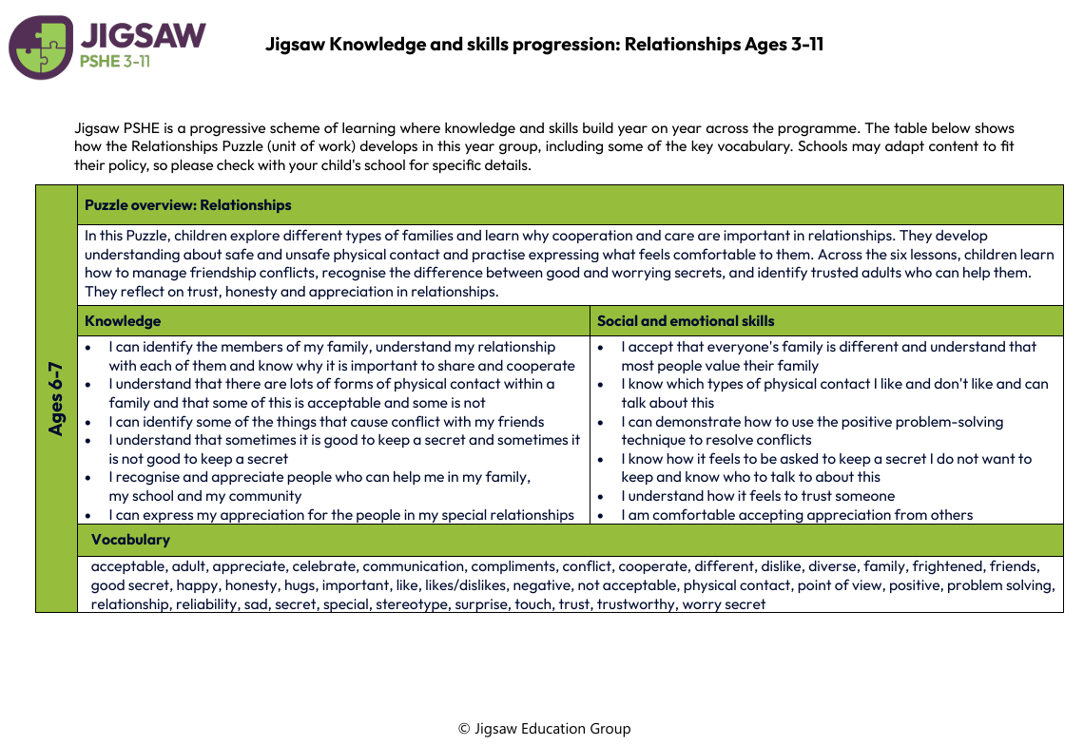
Year 2 PSHE – Summer 1

Slide 15
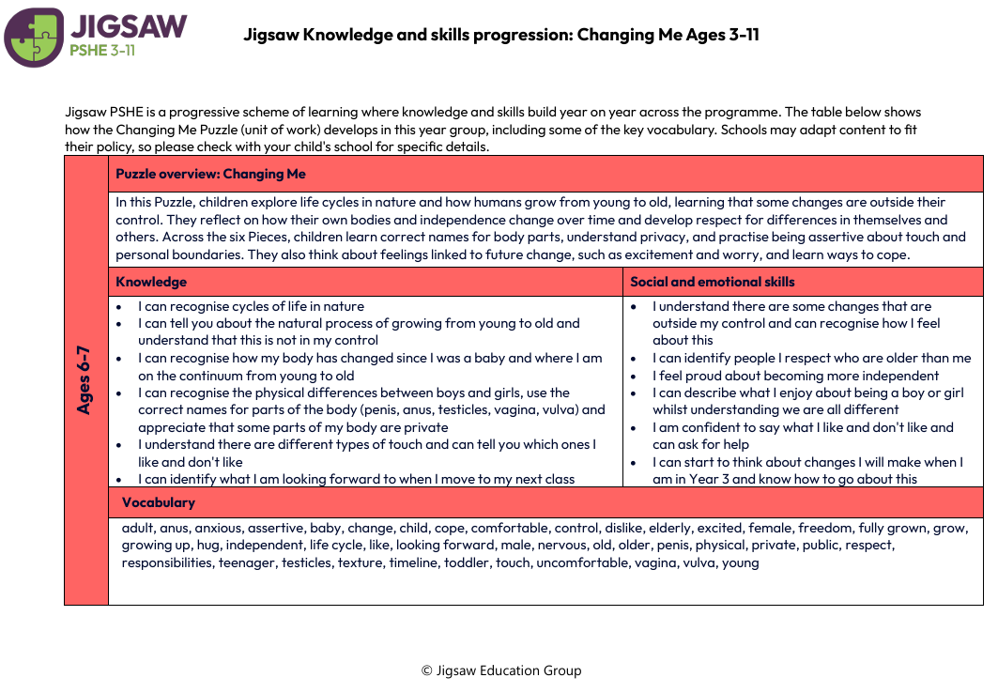
Year 2 PSHE – Summer 2

